Slide 1
Installation of Java

Slide 2
Why Java ?
Portable
Easy to learn
[ Designed to be used on the Internet ]

Slide 3
JVM
JVM stands for Java Virtual Machine
Unlike other languages, Java “executables” are executed on a CPU that does not exist.

Slide 4
Platform Dependent
myprog.c
gcc
myprog.exe
C source code
machine code
OS/Hardware
Platform Independent
javac
myprog.class
myprog.java
bytecode
Java source code
JVM
OS/Hardware

Slide 5
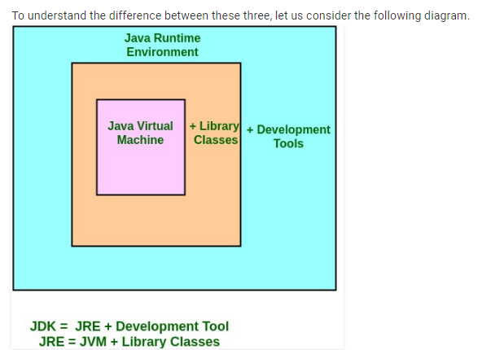
JDK, JRE, and JVM
JDK is for development purpose whereas JRE is for running the java programs.
JDK and JRE both contains JVM so that we can run our java program.
JVM is the heart of java programming language and provides platform independence.

Slide 6
Versions of Java
JDK Alpha and Beta (1995)
JDK 1.0 (23rd Jan 1996)
JDK 1.1 (19th Feb 1997)
J2SE 1.2 (8th Dec 1998)
J2SE 1.3 (8th May 2000)
J2SE 1.4 (6th Feb 2002)
J2SE 5.0 (30th Sep 2004)
Java SE 6 (11th Dec 2006)
Java SE 7 (28th July 2011)
Java SE 8 (18th March 2014)
Java SE 9 (21st Sep 2017)
Java SE 10 (20th March 2018)

Slide 7
Download the JDK
Go to the web site:
http://www.oracle.com/technetwork/java/javase/downloads/index.html or follow the links provide in the course’s web site.
Click on the first icon JAVA PLATFORM JDK 7
Accept the agreement for the download by clicking at the top of the table the accept agreement button.
Next choose your Operating System in your laptop (Windows for example). You probably want to click on the last choice (bottom link- windows 64) if you have windows or MAC environments. Click on that link.
Save the downloaded file in a known folder in your laptop.
After the download is complete, go to the folder where the file wa sdownloaded and click on it.
The installation starts and it would take few minutes. YOU ARE NOT DONE AFTER THE INSTALLATION IS COMPLETE.

Slide 8
How to set path in Java
The path is required to be set for using tools such as javac, java, etc.
If you are saving the Java source file inside the JDK/bin directory, the path is not required to be set because all the tools will be available in the current directory.
However, if you have your Java file outside the JDK/bin folder, it is necessary to set the path of JDK.
There are two ways to set the path in Java:
Temporary
Permanent

Slide 9
How to set the Temporary Path of JDK in Windows
To set the temporary path of JDK, you need to follow the following steps:
Open the command prompt
Copy the path of the JDK/bin directory
Write in command prompt: set path=copied_path
For Example:
set path=C:\Program Files\Java\jdk1.6.0_23\bin

Slide 10
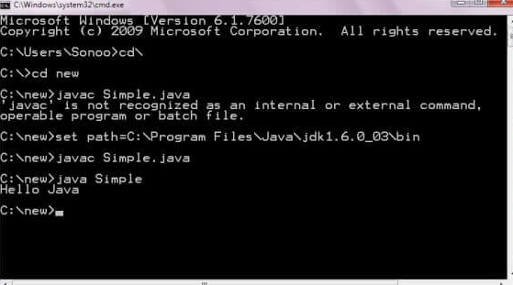

Slide 11
How to set Permanent Path of JDK in Windows
For setting the permanent path of JDK, you need to follow these steps:
Go to MyComputer properties -> advanced tab -> environment variables -> new tab of user variable -> write path in variable name -> write path of bin folder in variable value -> ok -> ok -> ok
Note: Open a DOS window.
Type the command to start the compiler without giving it a program name i.e.
>javac
If the installation and the PATH setting were done correctly the compiler will give you an error message with an indication of the proper commands to use.
If the PATH was done incorrectly then a message will appear like:
Command not recognized
In that case you will have to repeat the entire process of setting the PATH.

